Slide 1
Enhancing Human Robot Interaction Through Advanced User Testing
Development of robot-human co-creation in industry (ÕÜF9)
Presenter: Debora c Firmino de Souza
Notes:
Hello everyone!
First of all, thanks for having me in this seminar. Unfortunately, I could not be present with you today. But I hope that my virtual presence will be sufficient to introduce our topic and open the floor to further discussion.
I’m Debora C. Firmino de Souza, a PhD student and Junior Researcher at the Human-Computer Interaction Group at Tallinn University, and also part of the research group “Development of robot-human co-creation in industry”.

Slide 2
Table of contents
Autonomous robots in Industry 5.0
Human-robot collaboration & Trust
Trust barriers in implementing autonomous robotic systems
Key factors influencing trust in HRI
User testing to improve the quality of human-robot collaboration
What we can offer
Notes:
In this presentation, I’ll to share an overview of our current research findings and illustrate the potential advantages of state-of-the-art user experience evaluation methods brought from HCI for improving interactions with robotic systems.
On that note, I’ll briefly discuss the topics of autonomous robots in Industry 5.0, aspects of Trust in HRI, and lastly, refer to the core of this presentation, which is the user experience evaluation techniques suitable for assessing human-robot interaction.

Slide 3
Autonomous robots in Industry 5.0
Notes:
Before touching upon the core aspects of this presentation, I believe it is interesting to provide some definitions to clarify the scope of our investigation.

Slide 4
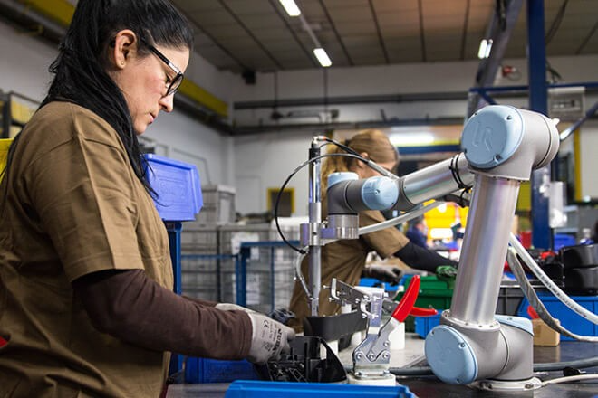
Autonomous robots in Industry 5.0
Industry 5.0: human-centric approach for efficient industrial innovation
optimal use of data-driven tools to improve process efficiency
Technological capabilities: data processing, accuracy and precision
Human capabilities: critical supervision and decision-making processes
Notes:
Industry 5.0 prioritizes human-centric and sustainable approaches for efficient industrial innovation. In other words, empowering workers with optimal use of data-driven tools to improve their process efficiency rather than replacing them by machines.
In that sense, technology should enable tools to augment the human ability to be creative and solve problems, benefiting from machine precision and data processing while preserving the human role in critical decision-making processes.
However, this configuration also brings along challenges in the design and adoption of autonomous technology to promote such seamless human-machine collaboration.

Slide 5
Human-robot collaboration & Trust
Notes:
Possible lenses to explore the phenomena considers human perceptions of technology and how they affect the individual’s disposition to trust: to rely on the technological counterpart.

Slide 6
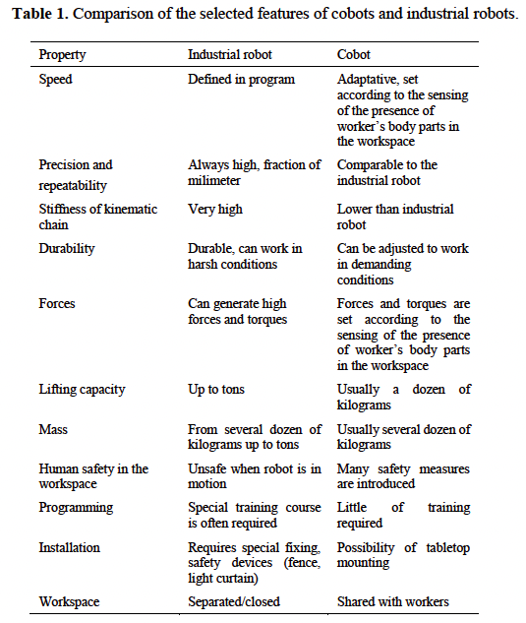
Human-robot collaboration & TRUST
HRI examines systems that are either operated by humans (e.g. via interfaces of any imaginable sort) or autonomous technologies that collaborate with humans.
COBOT “a robotic device which manipulates objects in collaboration with a human operator” ^{[2]}
The human leads the realization of the cooperation process
Human factor plays a relevant role
[1] Foit, K. (2022). Cobot as the Part of Multi-agent Model of a Manufacturing System. Journal of Physics: Conference Series, 2198(1), 012030. https://doi.org/10.1088/1742-6596/2198/1/012030
[2] Colgate JE, Peshkin MA, Wannasuphoprasit W. Cobots: Robots For Collaboration With Human Operators. In: International Mechanical Engineering Congress and Exposition, Atlanta; 1996. p. 433-40.
^{[1]}
Notes:
In the field of human-robot interaction (HRI), we study robotic systems that are either operated by humans (via human interfaces of any imaginable sort) or autonomous technologies that collaborate with humans.
Within that area of research, COBOTS are different from typical industrial robots both in their construction and in their mode of operation, as can be seen in the comparative table on the left.
In both cases, the human factor plays a relevant role. And therefore, the user experience.

Slide 7
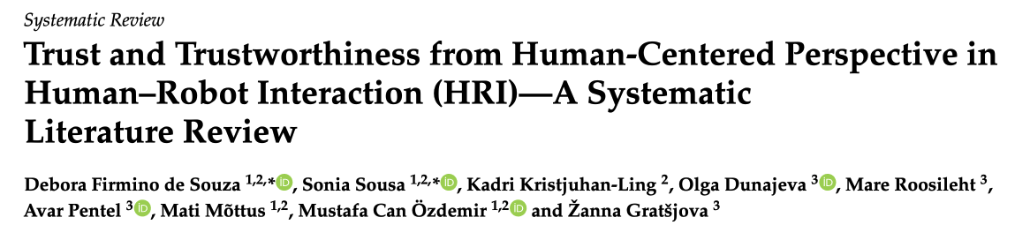
Human-robot collaboration & TRUST
Trust is essential for enabling the successful integration of autonomous technologies
Fosters user engagement ^{[3]}
Mediates reliance by supporting humans in overcoming potential complexities when interacting with robots ^{[4]}
One way of observing the phenomena considers human perceptions of technology and how they affect the individual’s disposition to trust.
[3] Gulati, S.; Sousa, S.; Lamas, D. Design, development and evaluation of a human–computer trust scale. Behav. Inf. Technol. 2019, 38, 1004–1015
[4] Lee, J.D.; See, K.A. Trust in automation: Designing for appropriate reliance. Hum. Factors 2004, 46, 50–80
Notes:
With that in mind, our research group conducted a systematic literature review focusing on trust and trustworthiness in relation to characteristics of humans and systems in human–robot interaction (HRI).
We explored the aspects that impact the potential for designing and fostering machine trustworthiness from a human-centered standpoint.
In our investigation, we identified and categorized factors influencing trust in HRI that can act as enablers and constrains for trust when implementing autonomous systems.
Trust - briefly defined here as the confidence we predict and place in someone or something behaving in a beneficial manner – has been pointed out by previous research as an essential interaction component to enable successful integration of autonomous technologies.

Slide 8
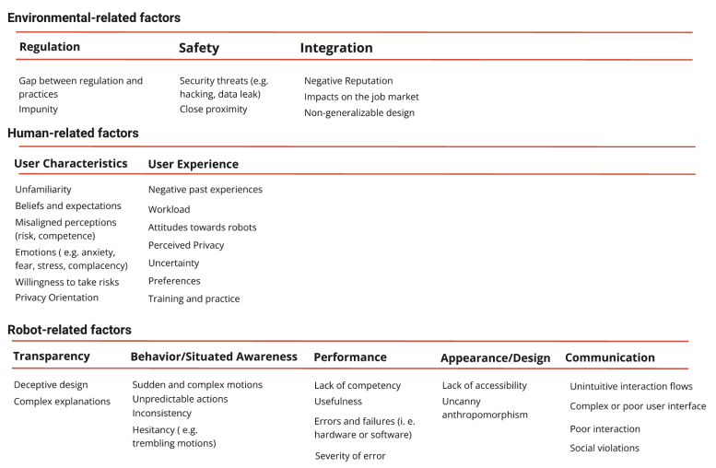
Trust and Trustworthiness from Human-Centered Perspective in HRI: Barriers
Notes:
By that token, we applied this classification to understand the variety of potential design cues and functionalities that can positively and negatively affect trust and, consequently, how trust calibration may support the integration of robots in diverse scenarios.
This way, we proposed a breakdown of the factors to clarify potential trust constraints (i.e., barriers) and enablers (i.e., facilitators). Each of the groups bring aspects gathered from literature in relation to the user, robot design or functionalities, and contextual elements that can mediate trust.

Slide 9
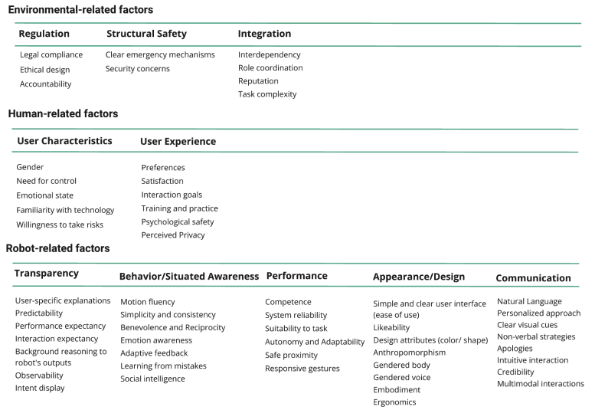
Trust and Trustworthiness from Human-Centered Perspective in HRI: facilitators
Notes:
The categories, derived from literature data, present then:
Environmental-related factors representing contextual considerations that include regulation, safety, and integration;
Human-related factors, which refer to user characteristics and their experiences; and
Robot-related factors: attributes concerning robotic systems, which are divided into transparency, communication, performance, behavior and situated awareness, and appearance and design.
Our classification is essentially helpful to underscore the value of designing robotic systems and evaluating their capability to communicate trustworthiness through optimized usability and increased transparency.
Moreover, as described in our analysis user characteristics and experience are pivotal aspects for engagement and adoption rates.

Slide 10
User testing to improve the quality of human-robot collaboration
How, what and Why evaluate the user experience?
Notes:
In terms of understanding users, HCI research provides validated methods and tools, in which complex problems can be addressed to improve human-technology interaction.
Understanding of the experience humans undergo when using technology accounts for the context of use, the needs of the user, the design, and evaluation of human-technology interaction.
So, how to proceed with such assessments?

Slide 11

How to assess the user experience?
Anytime is the right time
User testing can involve different participants
UX experts
Existing users
Potential users
Flexible formats:
Formative or Summative
One-to-one, Group sessions
In the wild, Lab, or Online studies
Qualitative, Quantitative: Questionnaires, Scales, Interview, Behavioral methods
Notes:
First, it’s important to acknowledge that anytime is the right time: UX evaluation can be run in every stage of product or system development
Also, User testing can involve different participants: depending on the stage and the goal of the evaluation
Besides, it allows flexible formats: as assessments can take either formative or summative approaches, and be carried out along individual or group sessions.
Also, different methods allow us to examine the interactions into the context of use or in experimental settings, both physical and online.
Either in quantitative or qualitative assessments, it is possible to deploy questionnaires, interviews or rely on behavioral methods to examine the user experience with the systems or products.

Slide 12

What to evaluate?
Objective: usability, safety and efficiency
Subjective: usefulness, attractiveness, trust and satisfaction
Screen based interfaces
Interactive objects in spatial environments
Notes:
Moreover, it is possible to run user testing on Screen based interfaces as well as on Interactive objects in spatial environments.
Additionally, the assessment can focus on objective or subjective aspects of the interaction

Slide 13
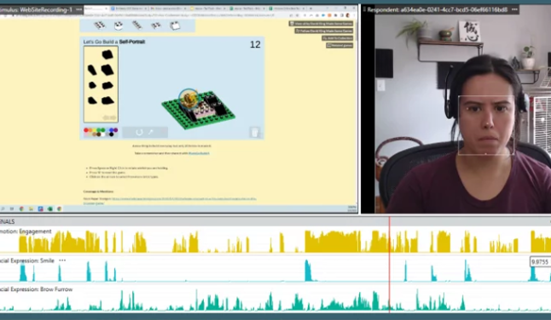

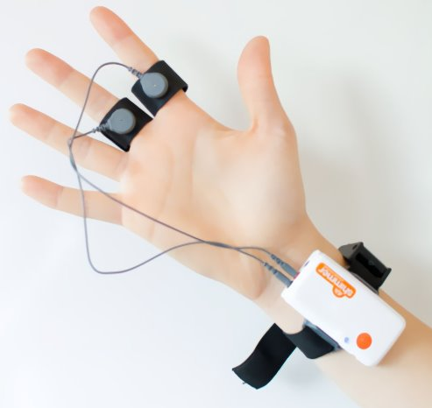
HCI@TLU: Our expertise
Use of behavioral methods to assess, for instance:
facial expression analysis for detecting emotions,
galvanic skin response for assessing arousal
heart rate analysis to detect stress
additional explanation to the user behaviour (e.g., gaze behaviour via eye tracking or body gesture analysis).
Notes:
Our team of HCI practitioners can provide counseling and expertise on the use of behavioral methods to assess, for instance: facial expression analysis for detecting emotions, galvanic skin response for assessing arousal or heart rate analysis to detect stress) and also additional explanation to their behaviour (e.g., gaze behaviour via eye tracking or body gesture analysis).
The nature of user testing can serve either to support the design of a new robotic system or to validating or comparing existing systems.

Slide 14

Why running UX evaluation?
Get structured feedback
Understand your product or systems performance
Examine user satisfaction (in depth)
Identify user experiences
Find out what works and what does not
Hear what users want and need
Plan potential improvements
Notes:
Among the reasons to run user testing in HRI, we may refer to the ability to Get structured feedback, Understand your product or systems performance, Examine user satisfaction (in depth), Identify user experiences, Find out what works and what does not, Hear what users want and need and Plan potential improvements

Slide 15
OUR RESEARCH TEAM:
Sonia Sousa
scs@tlu.ee
Mati Mõttus
matim@tlu.ee
Debora C Firmino de Souza
deboracs@tlu.ee
Mustafa Can Özdemir
rajaz@tlu.ee
THANK YOU!
Notes:
Thank you for your attention! And find me available to answer any questions you might have.

